Slide 1

Airbnb (new York) booking analysis

Slide 2

Agenda
Overview
Business Problems
Data Analysis
Conclusions

Slide 3

Overview
This analysis seeks to identify key factors impacting Airbnb prices in New York City, offering valuable insights for travelers, hosts, and Airbnb’s strategic planning. The project began with an in-depth data cleaning process, where we addressed missing values, inconsistencies, duplicates, and outliers to ensure a high-quality dataset. This careful preparation aimed to prevent biases and improve the accuracy of our analysis.
Once the dataset was refined, we conducted exploratory analysis using descriptive statistics and visualizations to summarize key trends and relationships within the data. Through various graphs and charts, we identified patterns related to pricing, availability, and neighborhood characteristics. This visual approach allowed us to uncover factors such as location, listing type, and seasonality that influence Airbnb prices.
Our findings provide a clearer understanding of price-driving variables and trends in the NYC Airbnb market, enabling data-backed insights for both users and business stakeholders. These insights can guide travelers in finding better deals, help hosts optimize listing prices, and assist Airbnb in refining their platform strategy for NYC.

Slide 4

Business problems
What are the most popular neighborhoods for Airbnb rentals in New York City? How do prices and availability differ across neighborhoods?
How has New York City's Airbnb market evolved over time? Are there notable trends in the number of listings, pricing, or occupancy rates?
Are there any clear patterns in the types of properties rented on Airbnb in New York City? Are certain property types more popular or tend to be priced higher?
Which factors appear to correlate with Airbnb rental prices in New York City?
Which areas in New York City offer the best opportunities for property investment at reasonable prices with high booking demand?
How do the lengths of stay for Airbnb rentals vary by neighborhood in New York City? Are there neighborhoods that attract longer stays more than others?
Is there a relationship between Airbnb rental ratings and prices in New York City? Are higher-priced listings more likely to have better ratings?
What are the total and maximum number of reviews for each neighborhood group?
Which room types are the most reviewed within each neighborhood group on a monthly basis?
Which listings or locations offer the best experience for travelers in New York City?
Which locations or properties are ideal for hosts in New York City?
How do prices vary across different neighborhood groups in New York City?

Slide 5

Business solution

Slide 6
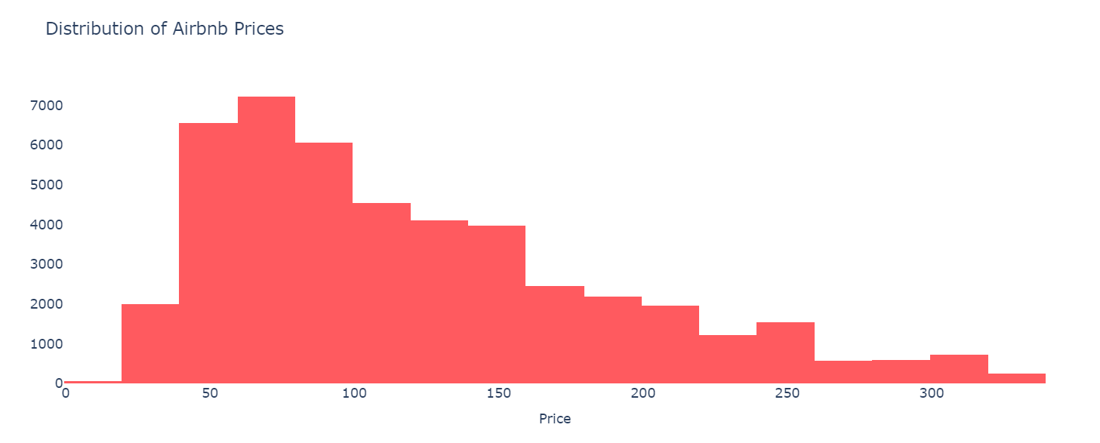
Distribution of Airbnb Booking Price Range

Slide 7
Observation
Airbnb prices range from $20 to $330, with most listings priced between $50 and $150.
The price distribution shows a peak in the $50 to $150 range, with relatively fewer listings in both higher and lower price ranges.
Listings priced above $250 appear to be fewer, as the density of listings drops sharply in this range.

Slide 8
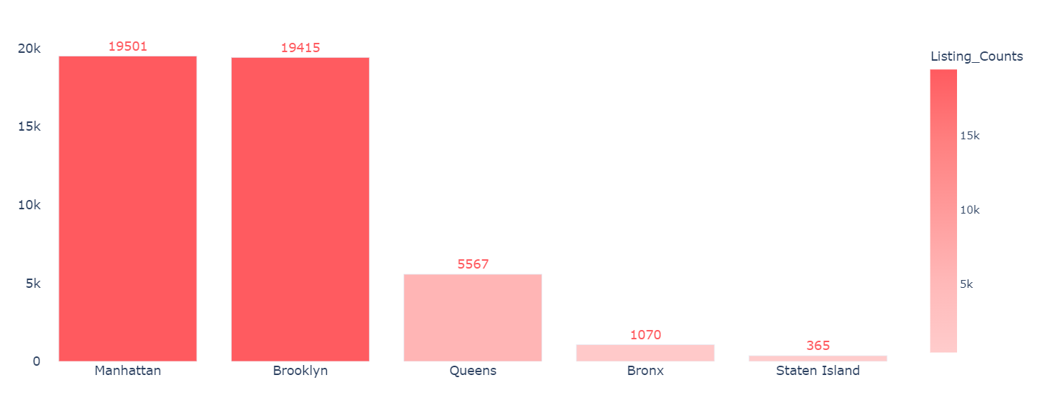
Total Listings/Property in Each Neighborhood Group

Slide 9
Observation
Manhattan and Brooklyn have the highest number of Airbnb listings, each with over 19,000 listings.
In contrast, Queens and the Bronx have significantly fewer listings, with 5,567 and 1,070 listings, respectively.
Staten Island has the lowest number of listings, with only 365.
The distribution of listings across neighborhood groups is imbalanced, with a heavy concentration in Manhattan and Brooklyn.
Despite being larger in size, neighborhoods in Queens, the Bronx, and Staten Island have fewer listings than Manhattan, which occupies a smaller geographical area.
This could indicate that demand for Airbnb rentals is higher in Manhattan compared to the other neighborhoods, resulting in a greater concentration of listings.
Alternatively, it may reflect a higher supply of listings in Manhattan due to the greater number of homeowners or property owners in the area willing to list their properties on Airbnb.

Slide 10
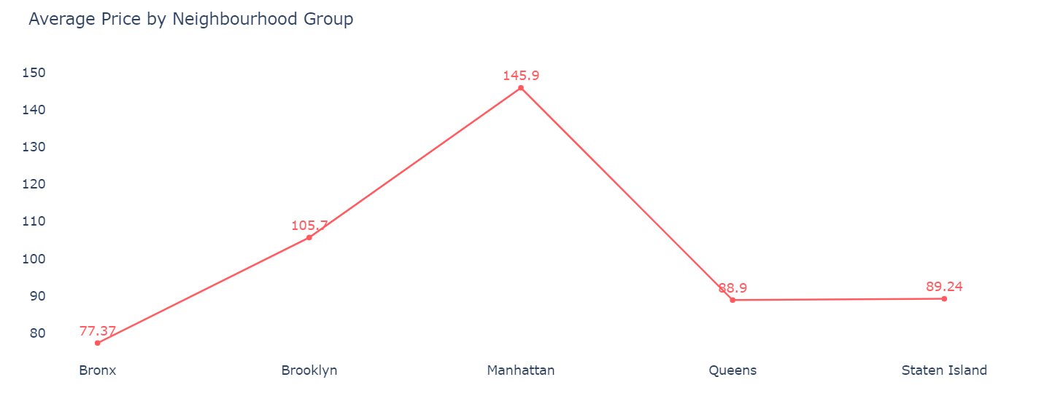
Average Price for Each Neighborhood Group

Slide 11
Observation
The average listing price in New York City varies widely across neighborhoods, with Manhattan having the highest average price of $146 per day, while the Bronx has the lowest at around $77 per day.
The second graph shows that price distribution is notably higher in Manhattan and Brooklyn. However, Manhattan exhibits more variety in its price range, as highlighted in the second violin plot.
As you move from the outer boroughs (Bronx, Brooklyn, Queens, and Staten Island) toward the city's center (Manhattan), the average price tends to increase.
Despite being in different areas, Queens and Staten Island have relatively similar average prices.
The data indicates that the overall cost of living in New York City is higher in Manhattan, the central borough, compared to the outer boroughs. This is likely because Manhattan is the most densely populated and economically significant borough, resulting in higher demand for housing in its centrally located neighborhoods.

Slide 12
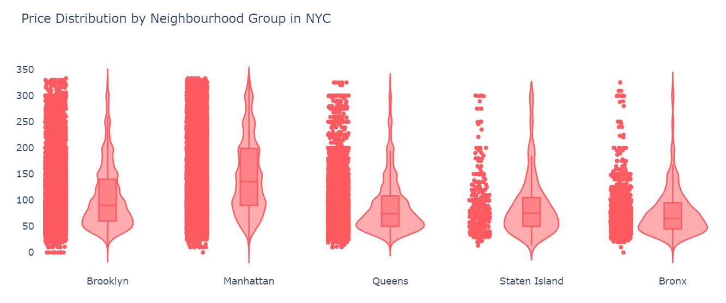
Price Distribution for Each Neighborhood Group

Slide 13
Observation
The price distribution is significantly higher in Manhattan and Brooklyn, with Manhattan showing more diversity in its price range, as seen in the violin plot.
Queens and the Bronx have similar price distributions, but Queens has a wider spread in the $50 to $100 range. However, the price diversity in Queens is not as pronounced as in Manhattan and Brooklyn.

Slide 14
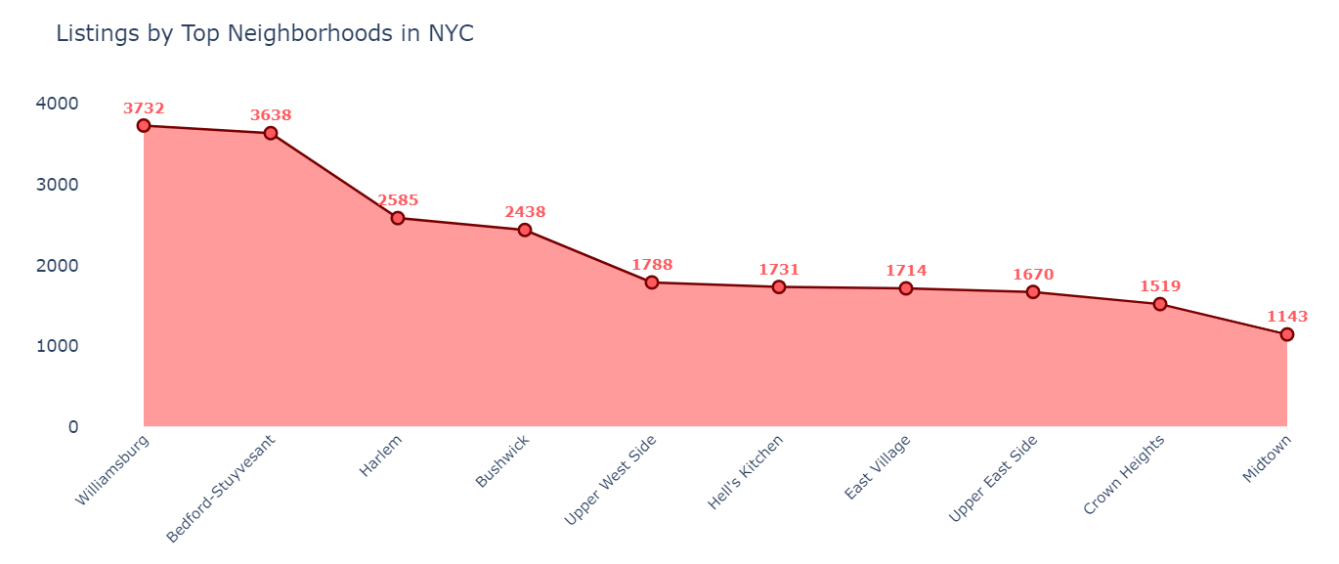
Top 10 Neighborhood by Listings/Property

Slide 15
Observation
The neighborhoods with the highest listing counts in New York City include Williamsburg, Bedford-Stuyvesant, Harlem, Bushwick, and the Upper West Side.
These top neighborhoods are predominantly situated in Brooklyn and Manhattan, likely reflecting the higher population density and greater demand for housing in these boroughs.
However, the number of listings alone may not fully capture the demand for housing in a neighborhood, as factors such as cost of living and housing availability also influence the market.

Slide 16
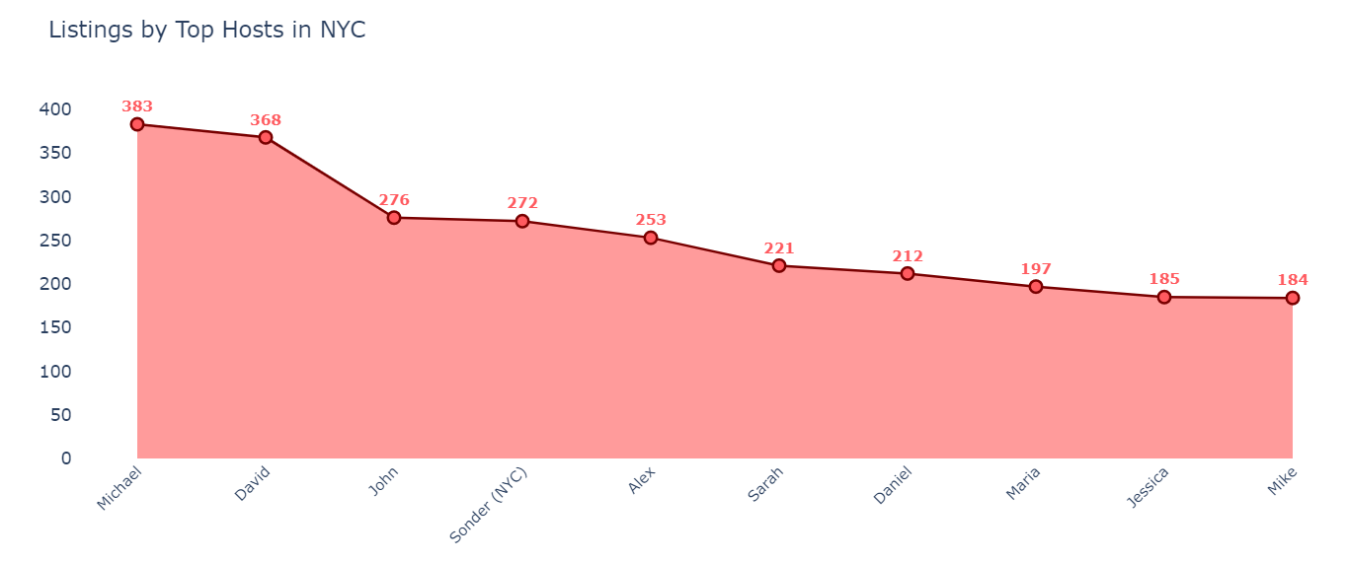
Top 10 Hosts by Listings/Property

Slide 17
Observation
The top three hosts by total listings are Michael, David, and John, with 383, 368, and 276 listings, respectively.
There is a noticeable gap between the top two hosts and the others. For instance, John has 276 listings, significantly fewer than Michael's 383 listings.
Among the top 10 hosts, Mike has 184 listings, which is much lower than Michael's 383 listings. This suggests a high level of variation in the success of different Airbnb hosts.
Only a few hosts have a large number of listings, indicating that the Airbnb market is highly competitive, with a small number of hosts controlling a significant portion of the market.

Slide 18
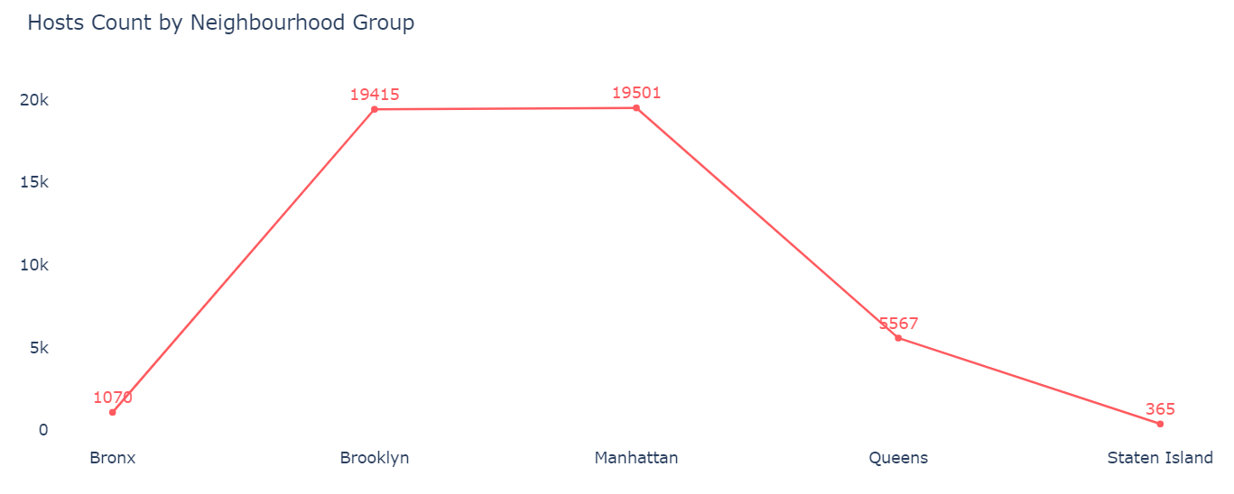
Active Hosts by Neighborhood Group

Slide 19
Observation
Manhattan leads with the highest number of hosts, totaling 19,501, followed closely by Brooklyn with 19,415 hosts.
Next in line are Queens with 5,567 hosts, followed by the Bronx with 1,070. Staten Island has the fewest hosts, with only 365.
Both Brooklyn and Manhattan have significantly more hosts than Queens, with over double the number, and they surpass the Bronx by more than 18 times.

Slide 20
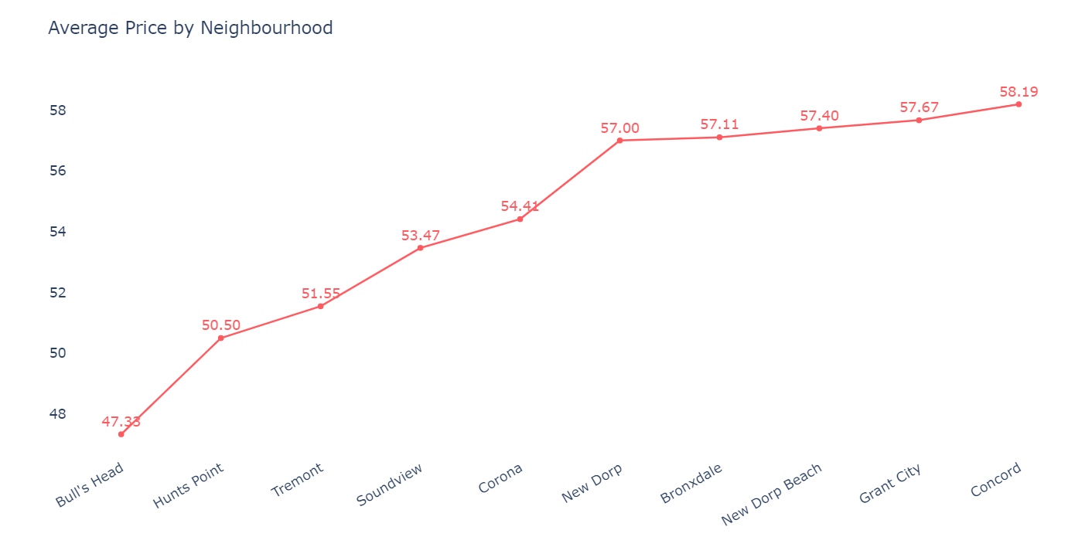
Average Minimum Price in Neighborhood

Slide 21
Observation
All of the neighborhoods listed are located in the outer boroughs of New York City (Bronx, Queens, and Staten Island). This suggests that these neighborhoods may have a lower overall cost of living compared to neighborhoods in Manhattan and Brooklyn.
The majority of these neighborhoods are located in the Bronx and Staten Island, which are known for having a more affordable cost of living compared to Manhattan and Brooklyn.
These neighborhoods may appeal to renters or buyers seeking more budget-friendly housing options within New York City.

Slide 22
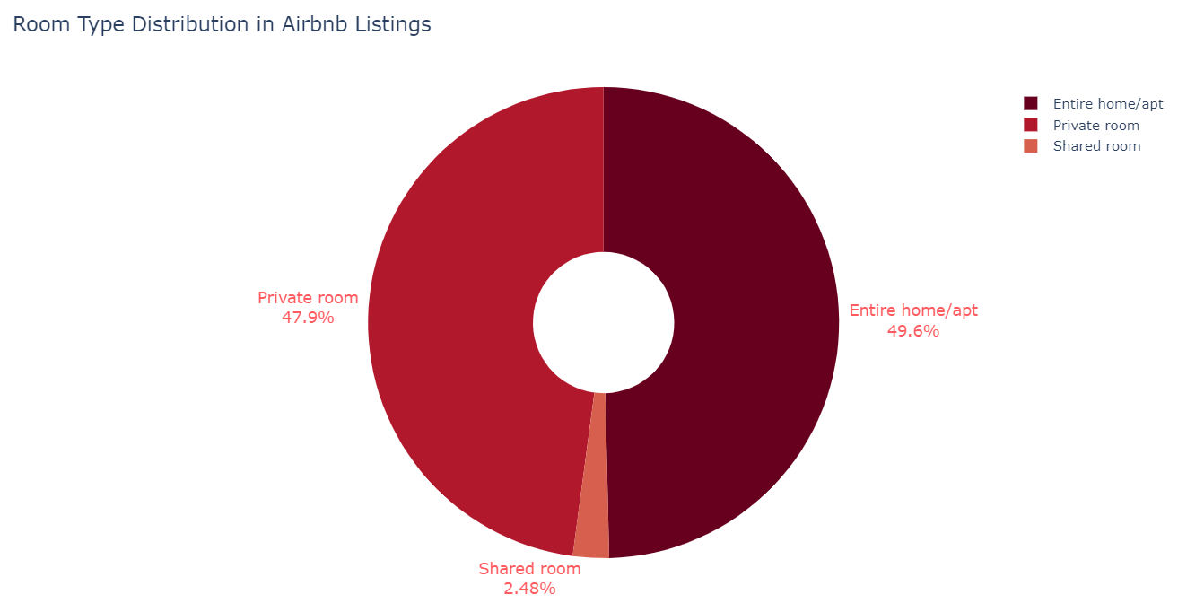
Each Room Type in NYC

Slide 23
Observation
The largest proportion of Airbnb listings are for entire homes or apartments, totaling 22,784 listings, followed by private rooms with 21,996 listings, and shared rooms with only 1,138 listings.
There is a notable disparity in the number of listings across different room types. For instance, entire homes or apartments outnumber shared rooms by nearly 20 times.
The data indicates that Airbnb offers a broad spectrum of accommodation options for travelers, ranging from private rooms to entire homes or apartments.

Slide 24
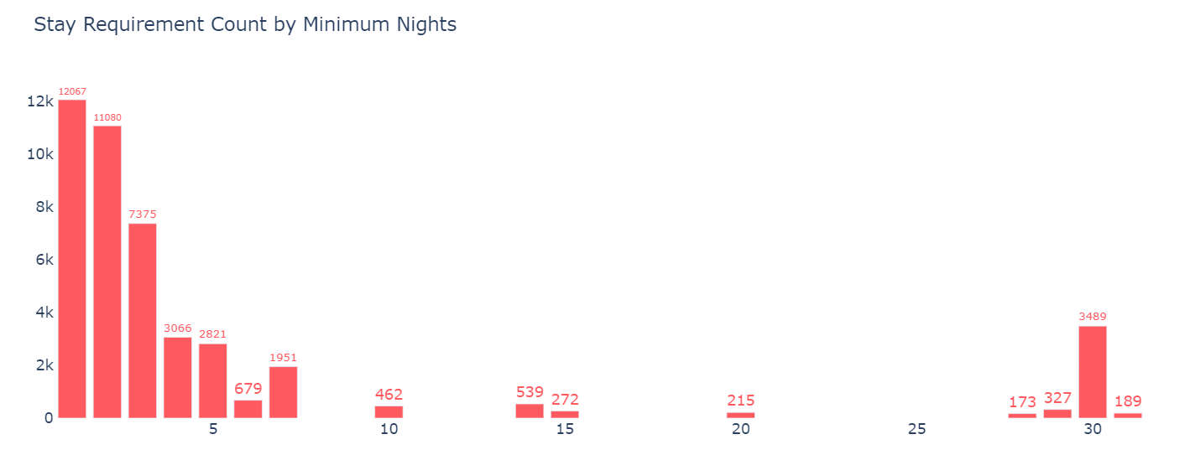
Stay Requirement by Minimum Night

Slide 25
Observation
The majority of Airbnb listings have a minimum stay requirement of either 1 or 2 nights, with 12,067 and 11,080 listings, respectively.
As the minimum stay requirement increases, the number of listings decreases, with 7,375 listings requiring a minimum stay of 3 nights, and fewer listings for longer stays.
Listings requiring a minimum stay of 30 nights or more are relatively scarce, with only 3,489 listings for 30 nights and just 189 listings for 60 nights or more.

Slide 26
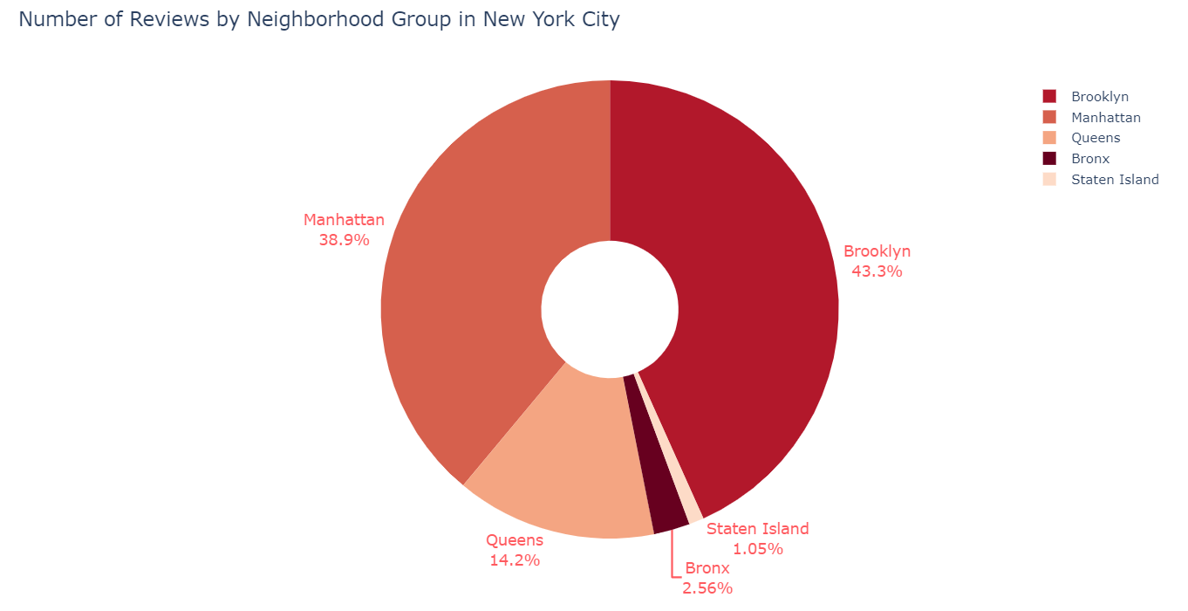
Total Reviews by Neighborhood Groups

Slide 27
Observation
Brooklyn accounts for the largest share of total reviews on Airbnb, contributing 43.3%, followed by Manhattan at 38.9%.
Queens holds the third-largest share with 14.2%, while the Bronx and Staten Island account for 2.6% and 1.0%, respectively.
The data suggests that Airbnb is more popular in Brooklyn and Manhattan than in other neighborhood groups.
Despite having fewer listings, Brooklyn generates more reviews on Airbnb compared to Manhattan. This could imply that Airbnb users in Brooklyn are more inclined to leave reviews, or that the listings in Brooklyn are either more popular or better at generating positive feedback. However, other factors, such as listing quality or the nature of travelers in these areas, could also play a role in this difference in reviews.

Slide 28
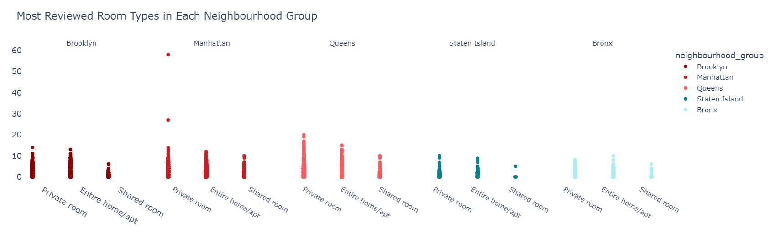
Most Reviewed Room Type by Neighborhood Groups

Slide 29
Observation
Private rooms received the highest number of reviews per month, with Manhattan leading the way, reporting more than 50 reviews per month, closely followed by Queens.
Brooklyn and Queens received the most reviews for the Entire home/apt room type.
Shared rooms garnered fewer reviews compared to other room types, with Staten Island having the lowest number of reviews, followed by the Bronx & Brooklyn.

Slide 30
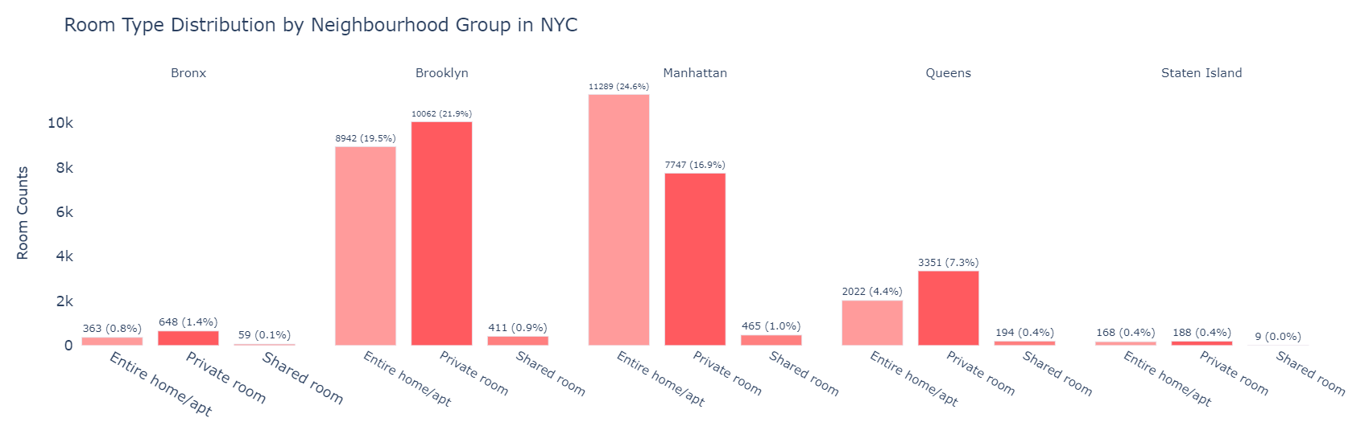
Distribution of Room Types in NYC

Slide 31
Observation
Manhattan has the highest proportion of listed properties with Entire home/apt, accounting for approximately 24.6 % of total listings, followed by Brooklyn at around 19.5 %.
Private rooms are more prevalent in Brooklyn, representing 21.9 % of total listings, followed by Manhattan with 16.9 %. Queens contributes to 7.3 % of the private room listings.
Shared rooms make up a very small portion of total listings on Airbnb, with virtually no shared rooms listed in Staten Island and the Bronx.
Overall, we observe that Brooklyn, Queens, and Manhattan have a higher concentration of private room listings, while Manhattan, which has the highest number of total listings in NYC, predominantly features Entire home/apt listings.

Slide 32
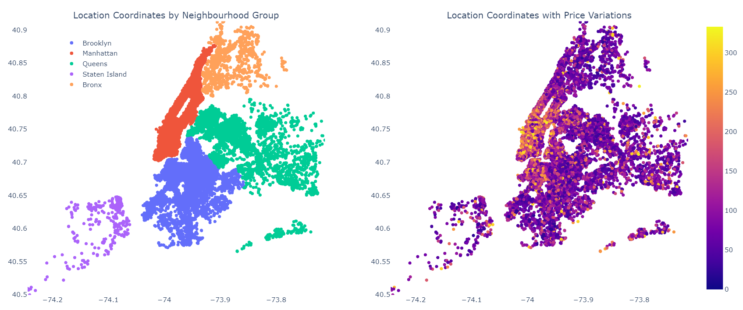
Neighborhood Groups vs Price variations

Slide 33
Observation
Link to Map : New York City Manhattan Printable Tourist Map | Tripomatic
Manhattan has a wide price range for accommodations, reflecting its status as the most expensive area to stay in NYC. This is due to the various premium amenities it offers.
The higher prices are likely driven by the abundance of valuable attractions, making Manhattan a top choice for tourists and visitors.
With its popular amenities, high concentration of tourist destinations, and extensive public transport options, travelers are more likely to stay longer in Manhattan.

Slide 34
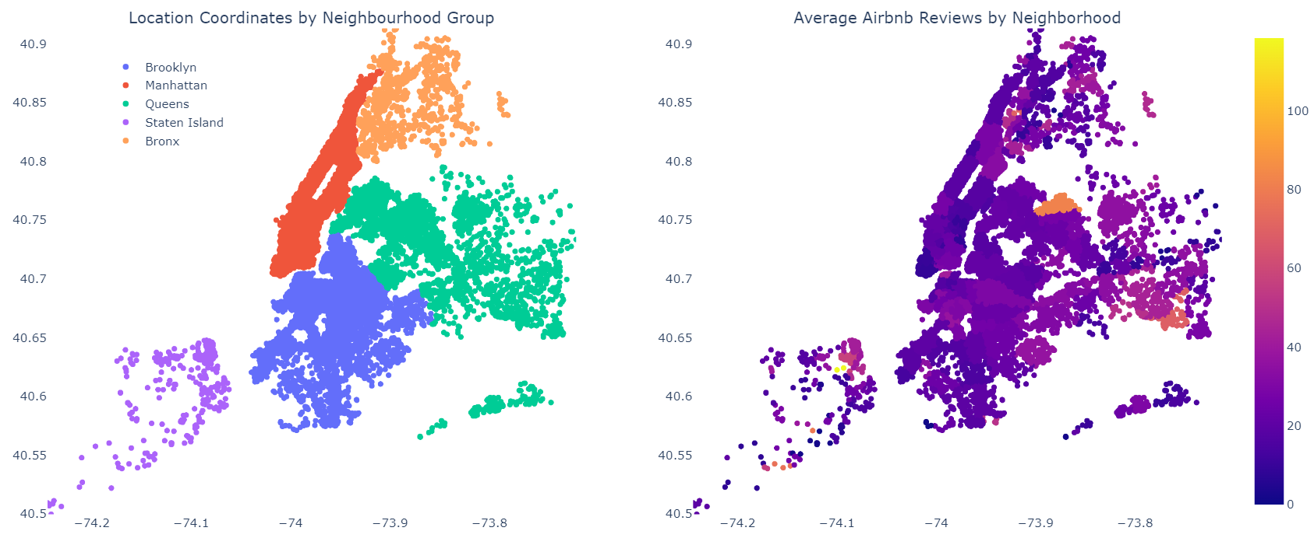
Best Property Location for Travelers/Hosts by Avg. Reviews

Slide 35
Observation
Link to Map : New York City District Map - New York City – Travel guide at Wikivoyage
I have attached a photo of this map to highlight some valuable insights. The neighborhoods near the airport in Queens appear to have a higher average number of reviews, likely due to their proximity to the airport. These areas are more convenient and appealing for travelers passing through, making them a popular choice for stays.
Several factors may contribute to the higher average reviews in these neighborhoods. For instance, they could feature a higher concentration of high-quality listings or local attractions that draw more visitors, leading to more reviews. The proximity to the airport seems to be a key factor behind this trend, which makes logical sense.

Slide 36
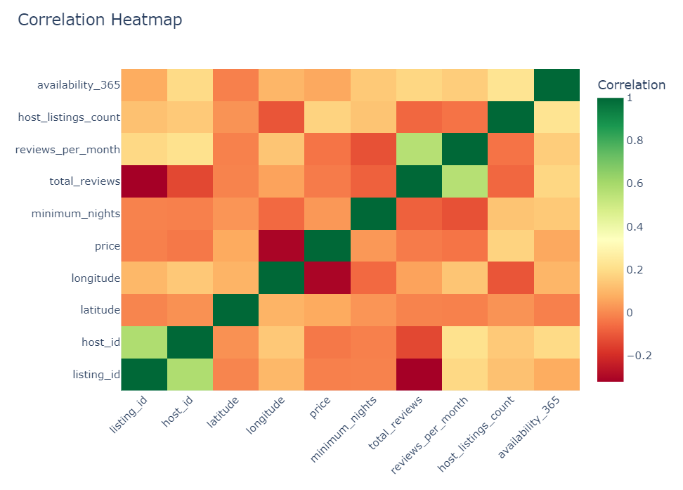
Correlation Heatmap

Slide 37
Observation
A moderate positive correlation of 0.58 exists between the host_id and id columns, indicating that hosts with more listings are more likely to have unique host IDs.
A weak positive correlation of 0.17 is observed between the price column and the calculated_host_listings_count, suggesting that hosts with a higher number of listings generally charge higher prices.
A moderate positive correlation of 0.23 is found between the calculated_host_listings_count and the availability_365, indicating that hosts with more listings tend to have a higher number of available days in the upcoming 365 days.
A strong positive correlation of 0.58 is present between the number_of_reviews and reviews_per_month columns, suggesting that listings with a higher total number of reviews also tend to receive more reviews each month.

Slide 38

conclusion

Slide 39
Manhattan and Brooklyn are the most sought-after areas for Airbnb rentals, as seen by the large number of listings in these neighborhoods. This high demand makes them attractive locations for hosts looking to invest in property.
Manhattan, famous for its parks, museums, iconic landmarks, and constant influx of tourists throughout the year, justifies both high demand and elevated rental prices. Its global recognition makes it a premium area for Airbnb rentals.
Brooklyn, with its large number of listings and more affordable prices compared to Manhattan, is a close second. Neighborhoods like Williamsburg and Bedford-Stuyvesant, strategically located near Manhattan, offer tourists the opportunity to enjoy both boroughs while spending less.
Williamsburg, Bedford-Stuyvesant, Harlem, Bushwick, and the Upper West Side stand out as the top neighborhoods in terms of listings, highlighting strong demand for Airbnb rentals in these areas.
The average price of a listing in New York City is notably higher in Manhattan's central areas, compared to the outer boroughs. This suggests that investing in Manhattan properties may offer more lucrative returns for Airbnb hosts, although the high competition within these boroughs is a factor to consider.

Slide 40
The data indicates that Airbnb rentals in New York City are primarily used for short-term stays, with few listings requiring a minimum stay of 30 nights or more. Hosts might want to focus on properties suited for shorter stays to maximize their occupancy rates.
Most Airbnb listings are for entire homes or apartments, with private rooms also being popular, while shared rooms are less common. This variety offers travelers a wide range of accommodation options, and hosts may want to consider properties that can accommodate multiple guests.
There is a notable variation in the availability of Airbnb rentals across neighborhoods, with some areas having a high concentration of listings and others having far fewer options.
The competition among Airbnb hosts is intense, with a small number of hosts dominating a significant portion of the market. Hosts looking to stand out might consider investing in neighborhoods with fewer listings to differentiate themselves from the competition.
Neighborhoods near the airport in Queens tend to have a higher average number of reviews. These areas are likely to attract tourists passing through, making them an appealing option for short-term stays. Additionally, the more affordable pricing in these areas, compared to Manhattan and Brooklyn, further enhances their attractiveness for budget-conscious travelers.

Slide 41

THANK YOU
Akashdeep Dam
akashdeepdam@gmail.com

